Slide 1

Introduction to Big Data and Hadoop
Name
Title
Microsoft Corporation

Slide 2
Agenda
Why Big Data?
Understanding the Basics
Microsoft and Hadoop

Slide 3
Why Big Data?

Slide 4

1.8 ZETTABYTES
Of Information will be created in 2011
Source: CenturyLink resource center, as reported in The readwriteweb, Nov 17, 2011

Slide 5
7.9 ZETTABYTES
By 2015
Source: CenturyLink resource center, as reported in The readwriteweb, Nov 17, 2011

Slide 6

Bing ingests > 7 petabytes a month
The Twitter community generates over 1 terabyte of tweets every day
Cisco predicts that by 2013 annual internet traffic flowing will reach 667 exabytes
Sources: The Economist, Feb ‘10; DBMS2; Microsoft Corp

Slide 7



Slide 8
Example Scenario

Slide 9
Traditional E-Commerce Data Flow
OPERATIONAL DATA
NEW USER REGISTRY
NEW PURCHASE
NEW PRODUCT
Data Warehouse
ETL Some Data
Logs
Excess Data

Slide 10
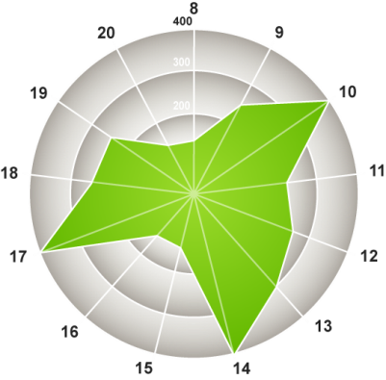
New E-Commerce Big Data Flow
OPERATIONAL DATA
NEW USER REGISTRY
NEW PURCHASE
NEW PRODUCT
Logs
Data Warehouse
Raw Data
“Store it All”
Cluster
Logs
How much do views for certain products increase when our TV ads run?
Raw Data
“Store it All”
Cluster

Slide 11
Understanding the Basics Move the Compute to the Data

Slide 12


Characteristics of Big Data
New Data Sources
Large Data Volumes
New Technologies
Non-traditional Data Types
New Economics
New Questions & New Insights

Slide 13
MapReduce

Slide 14
So How Does It Work?
FIRST, STORE THE DATA
Server
Server
Files
Server
Server

Slide 15

So How Does It Work?
SECOND, TAKE THE PROCESSING TO THE DATA
RUNTIME
Code
// Map Reduce function in JavaScript
var map = function (key, value, context) {
var words = value.split(/[^a-zA-Z]/);
for (var i = 0; i < words.length; i++) {
if (words[i] !== "")
context.write(words[i].toLowerCase(),
1);}
}};
var reduce = function (key, values, context) {
var sum = 0;
while (values.hasNext()) {
sum += parseInt(values.next());
}
context.write(key, sum);
};
Server
Server
Server
Server

Slide 16

MapReduce – Workflow
A MapReduce job usually splits the input data-set into independent chunks which are processed by the map tasks in a completely parallel manner
The framework sorts the outputs of the maps, which are then input to the reduce tasks
The framework takes care of scheduling tasks, monitoring them and re-executes the failed tasks
Input Domain
Map
Map
Map
Intermediate Domain
Intermediate Domain
Intermediate Domain
Reduce
Reduce
Reduce
Intermediate Domain
Reduce
Output domain

Slide 17


MapReduce – Workflow
Data
Acquisition
& Modeling
Collaboration
& Visualization
Analysis & Data Mining
Dissemination, Sharing, Preservation
It takes more time to hand a project from the seismic guys to me to the engineers in production than it does to figure out the oil field plays.
Geologist, Major oil and gas company
Our weather model and resulting data sets should be accessible to universities and other institutions.
Aerospace Development Manager, U.S. Federal Government

Slide 18
Hadoop

Slide 19
Hadoop Architecture
Task tracker
Task tracker
MapReduce Layer
Job tracker
Name node
HDFS Layer
Data node
Data node
Reference: http://en.wikipedia.org/wiki/File:Hadoop_1.png
Notes:
,

Slide 20

Traditional RDBMS vs. MapReduce
 | Traditional RDBMS | MapReduce
Data Size | Gigabytes (Terabytes) | Petabytes (Hexabytes)
Access | Interactive and Batch | Batch
Updates | Read / Write many times | Write once, Read many times
Structure | Static Schema | Dynamic Schema
Integrity | High (ACID) | Low
Scaling | Nonlinear | Linear
DBA Ratio | 1:40 | 1:3000
Reference: Tom White’s Hadoop: The Definitive Guide

Slide 21

The Hadoop Ecosystem
ETL Tools
BI Reporting
RDBMS
Zookeepr (Coordination)
Pig (Data Flow)
Hive (SQL)
Sqoop
Avro (Serialization)
MapReduce (Job Scheduling/ Execution System)
Hbase (Column DB)
HDFS (Hadoop Distributed File System)
Reference: Tom White’s Hadoop: The Definitive Guide

Slide 22
Microsoft and Hadoop

Slide 23
Detailed Offerings
INSIGHTS
Hive ODBC Driver & Hive Add-in for Excel
Integration with Microsoft PowerPivot
ENTERPRISE
READY
Hadoop based distribution for Windows Server & Azure
Strategic Partnership with Hortonworks
BROADER
ACCESS
JavaScript framework for Hadoop
RTM of Hadoop connectors for SQL Server and PDW

Slide 24

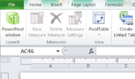
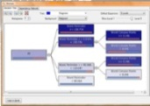
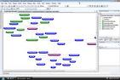
Microsoft Big Data Solution
FAMILIAR END USER TOOLS
Power View
Excel with PowerPivot
Predictive Analytics
Embedded BI
BI PLATFORM
SSAS
SSRS
Microsoft EDW
Connectors
Hadoop On Windows Azure
Hadoop On Windows Server
UNSTRUCTURED & STRUCTURED DATA
Sensors
Devices
Bots
Crawlers
ERP
CRM
LOB
APPs

Slide 25
Deploying and Interacting With a Hadoop Cluster on Azure
demo

Slide 26
Hadoop on Windows Insights to all users by activating new types of data
Differentiation
INSIGHTS
Integrate with Microsoft Business Intelligence
Choice of deployment on Windows Server + Windows Azure
Integrate with Windows Components (AD, Systems Center)
ENTERPRISE
READY
Easy installation and configuration of Hadoop on Windows
Simplified programming with . Net & Javascript integration
Integrate with SQL Server Data Warehousing
BROADER
ACCESS
Contributions proposed back to community distribution

Slide 27
Microsoft Big Data Roadmap
Microsoft is extending its leadership in business intelligence and data warehousing to provide insights to all users by activating new types of data of any size
To accelerate the delivery of Microsoft’s Hadoop based solution for Windows Server and service for Windows Azure, Microsoft is announcing a partnership with Hortonworks
Microsoft is announcing an end-to-end roadmap for Big Data that embraces Apache HadoopTM by distributing enterprise class Hadoop based solutions on both Windows Server and Windows Azure
Microsoft is committed to broadening accessibility and usage of Hadoop to end users, developers and IT professionals in organizations of all sizes

Slide 28
Resources
http://www.hadooponazure.com/
http://hadoop.apache.org/

